Slide 1
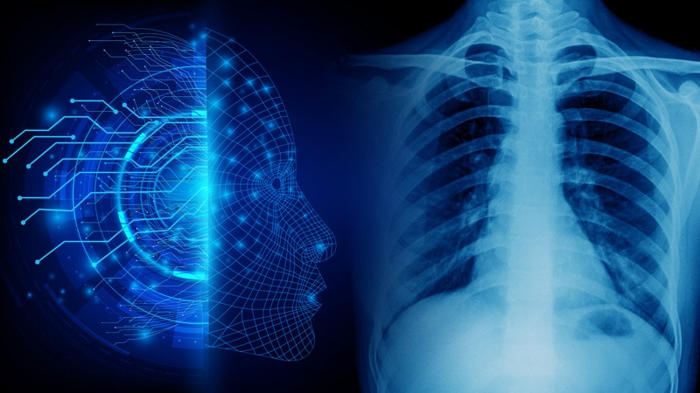
Transforming Medical Imaging with Deep Neural Network-based Chest X-ray Analysis
GROUP N
Sadath Roshan (40224159)
Sraddha Bhattacharjee (40221370)
Saketh Oppula (40221013)
Leesha Shah (40198534)

Slide 2
PROBLEM STATEMENT AND GOAL
Introduction: Medical Imaging plays a crucial role in modern healthcare by enabling medical professionals to make more informed diagnostic decisions. However, manual interpretation of chest X-rays can be a challenging, time-consuming, and error-prone process, even for expert radiologists in accurately diagnosing diseases. With the advancement of AI, there has been a significant transformation in the healthcare field. Therefore, our project employs state-of-the-art AI models such as AlexNet, ResNet18, and Inceptionv3 to train on multiple datasets with varying complexity to aid in the diagnosis of respiratory and cardiovascular conditions in patients.
The scope of our project involves examining the effect of different factors, such as model architecture, dataset complexity, hyperparameter optimization, and transfer learning, on the diagnostic ability of these models.
Challenges faced:
Although there are numerous medical imaging datasets accessible, it was difficult to locate datasets with a significant amount of precisely labeled images.
Deep learning models must be trained using a lot of computational power, especially specialized GPUs, on medical imaging datasets. To train the models, we required increasingly powerful computing devices.
Complex elements in chest X-ray pictures, such as differences in shape, texture, and illumination, made it challenging for models to correctly categorize diseases.
High Level Results: We discovered that the best performance for all models was obtained on the first dataset, and ResNet18 outperformed the other models on all two datasets. After analyzing the results, we found that for dataset 1, ResNet18 achieved the highest accuracy among all the models tested. On the other hand, for dataset 2, AlexNet outperformed the other models by a significant margin.

Slide 3
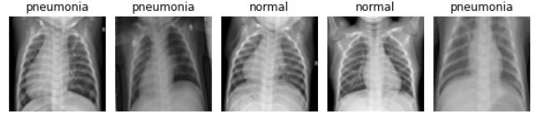
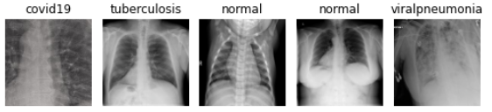
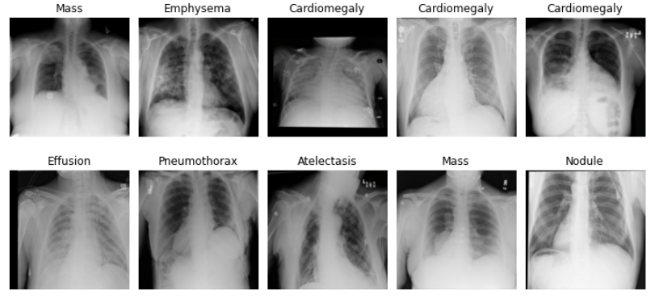
DATASETS
To perform disease classification from Chest X-rays, we chose the datasets publicly available from Kaggle namely, the Chest Xray Images, Chest X-Ray Dataset for Respiratory Disease Classification, NIH Chest Xray-14
Dataset 1 consists of 5,856 chest X-ray images of patients with and without Pneumonia. The dataset consists of 2 classes Normal (1,342) and Pneumonia (4,514), of size 1024*1024.
Dataset 2 contains a total of 32,687 images with 5 classes of respiratory diseases, including COVID-19 (4,189), Lung-Opacity (6,012), Normal (10,192), Viral Pneumonia (7,397), and Tuberculosis (4,897), of size 224*224. We have sampled 12,000 images from this dataset.
Dataset 3 is the NIH Chest X-rays dataset which is a collection of 112,120 frontal-view chest X-ray images of 30,805 unique patients, of which we sample 20,000 images. This comprises of 15 different classes including Atelectasis, Consolidation, Infiltration, Pneumothorax, Edema, etc.
Figure 1: Dataset 1
Figure 2: Dataset 2
Figure 3: Dataset 3

Slide 4
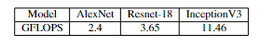
CNN MODELS
ResNet18 is effective for small to medium-sized datasets and can achieve high accuracy with relatively low computational resources. It is known for its ability to overcome the vanishing gradient problem. It has11,689,512 parameters, with 18 layers, and requires an input size of 224*224.
AlexNet was designed to work well on large datasets due to its ability to learn complex image features by combining convolutional layers and max pooling layers along with the use of data augmentation techniques to prevent overfitting. It has a total of 8 layers (5 convolutional and 3 fully connected) with 61,100,840 model parameters. It takes a 224*224 image as input.
InceptionV3 is a more recent architecture built to tackle the problem of computational efficiency in large datasets. It has a total of 159 layers but uses a combination of 1x1, 3x3, and 5x5 convolutions to extract the smallest of features from input images. It uses 23,851,784 model parameters and requires an input image size of 299*299.
GFLOPS is a measure of computing performance, particularly in the field of high-performance computing (HPC). In the context of machine learning performance benchmarks, a commonly used metric is the number of Giga Multiply-Add operations per second (GMACs/s). GMACs/s is roughly half the value of GFLOPs/s, assuming the use of FMA instructions. Table 1 shows a comparison of the computational complexity of the models
Table 1: Comparison of GFLOPS for different model
Notes:
AlexNet was designed to work well on large datasets due to its ability to learn complex image features through its use of a combination of convolutional layers and max pooling layers, along with the use of data augmentation techniques to prevent overfitting. It has a total of 8 layers (5 convolutional and 3 fully connected) with 61,100,840 model parameters. It takes a 224*224 image as input.

Slide 5
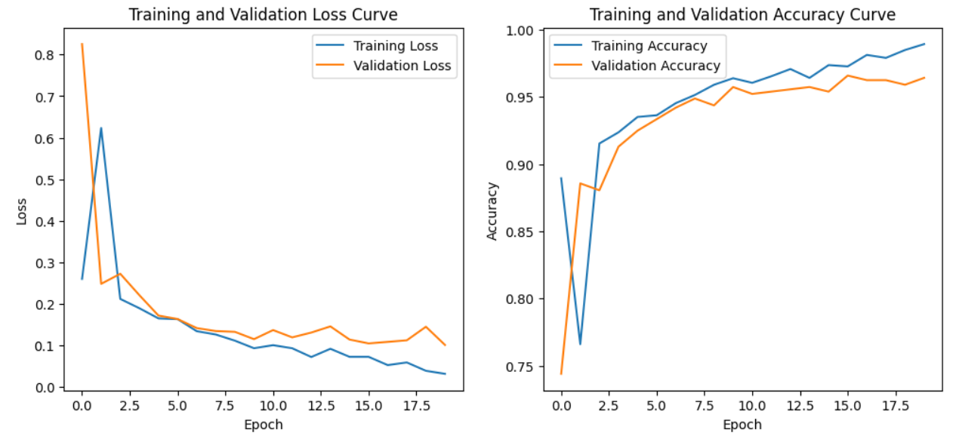
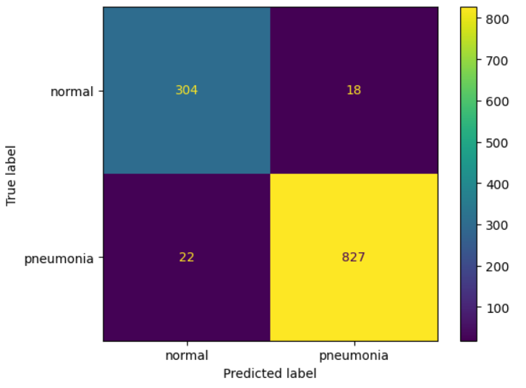
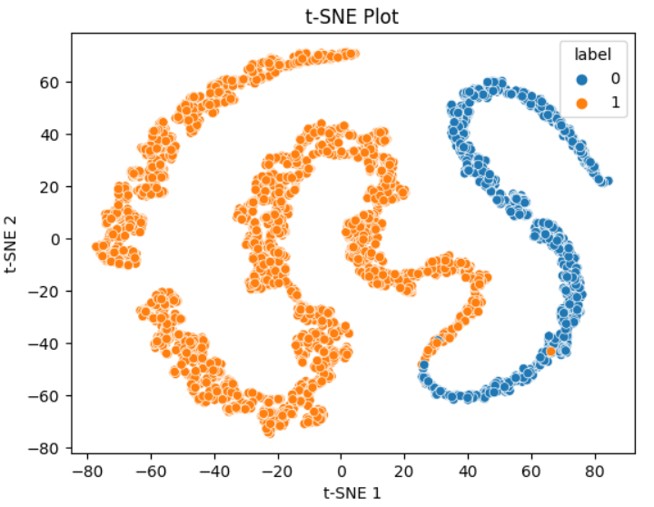
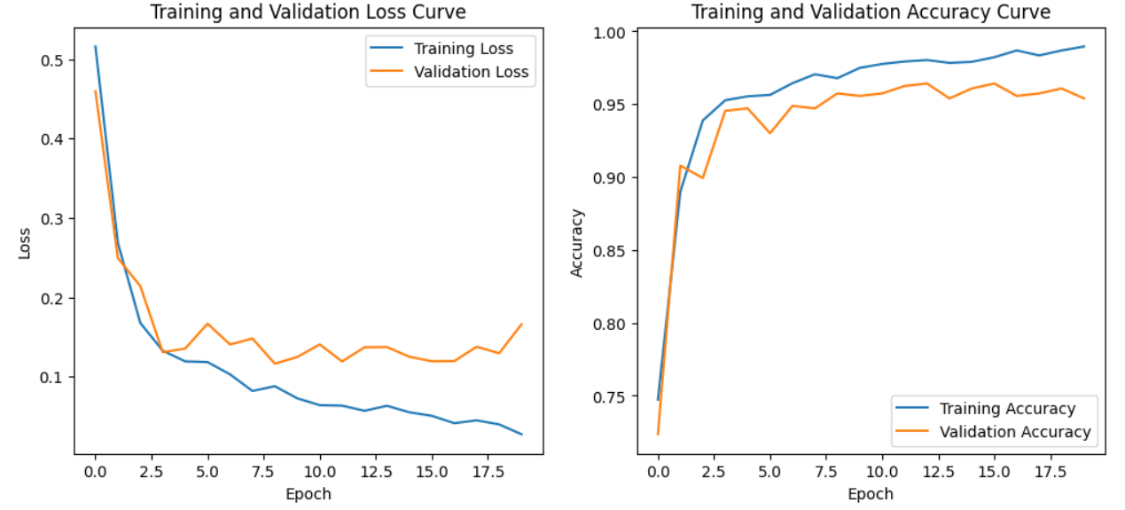
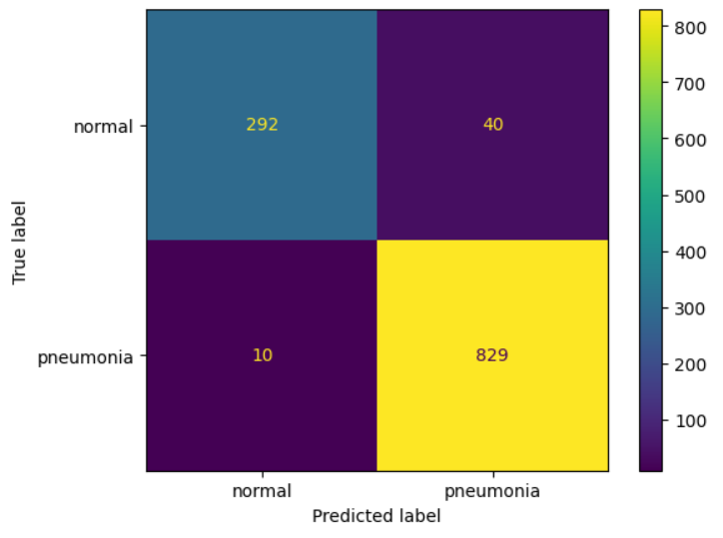
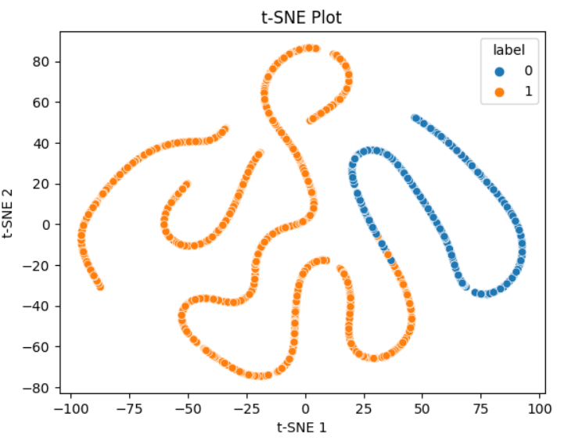
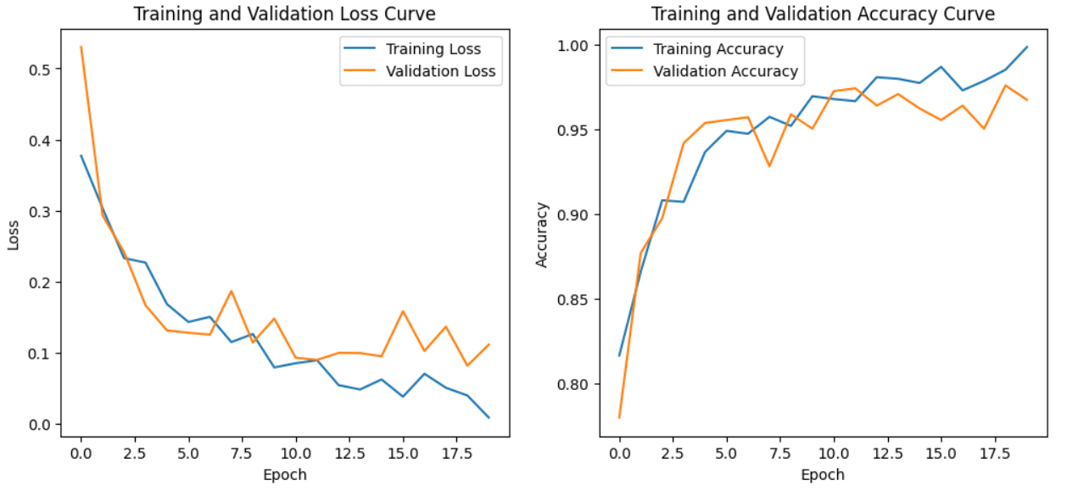
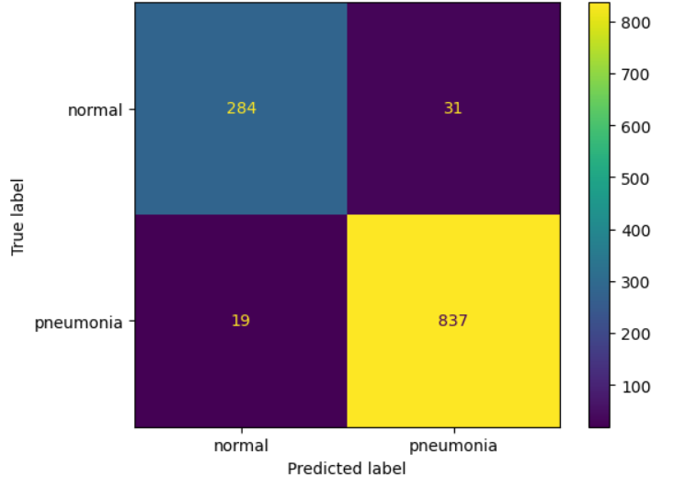
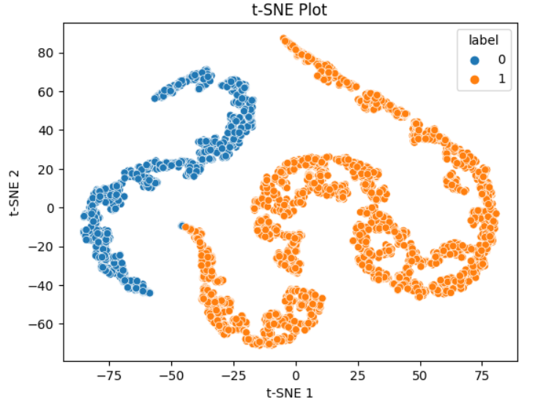
The first dataset, D1, is less complex with fewer images, and all three models perform exceptionally well, with ResNet18 being the best-performing model.
ResNet-18 metrics on Dataset 1
AlexNet metrics on Dataset 1
InceptionV3 metrics on Dataset 1

Slide 6
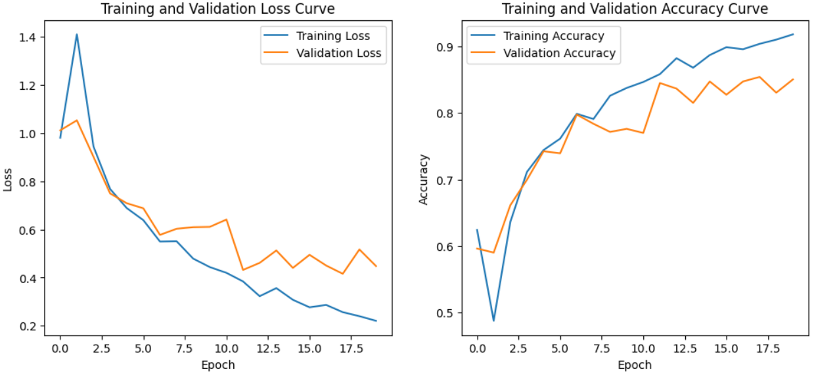
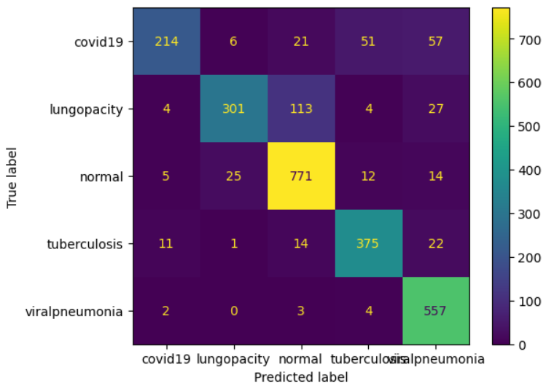
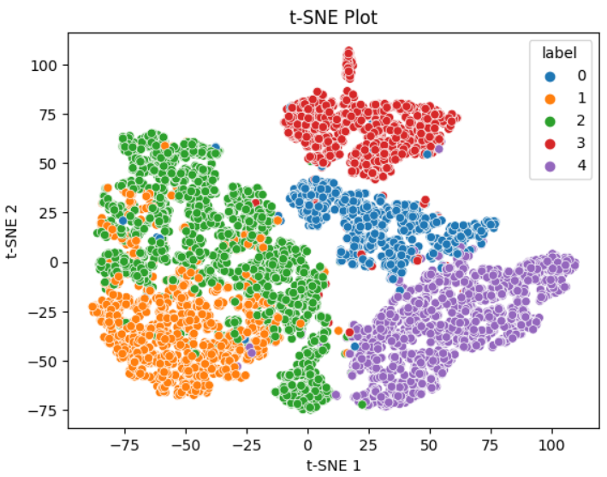
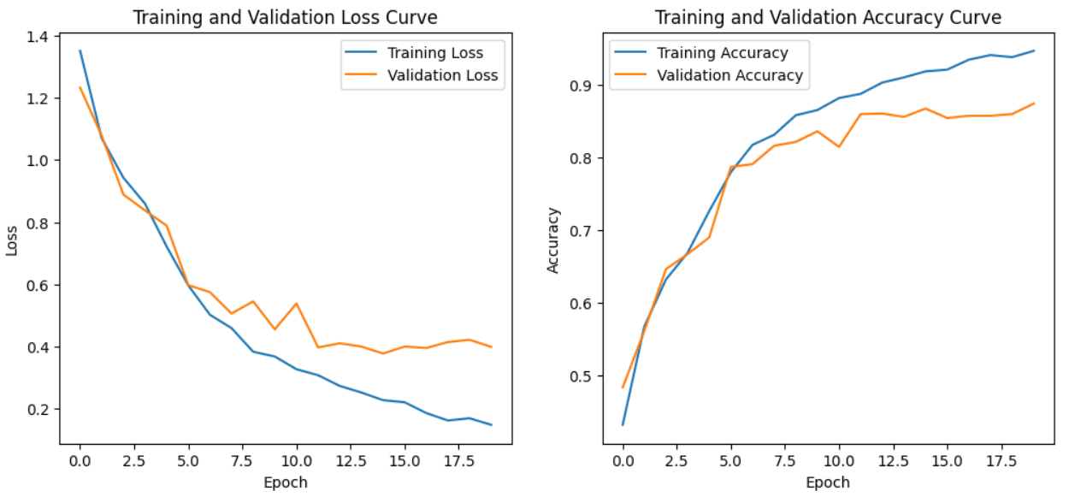
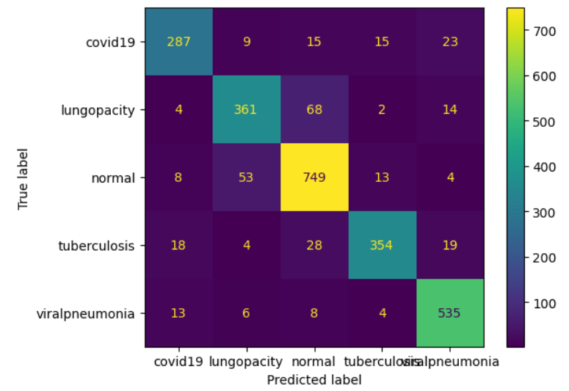
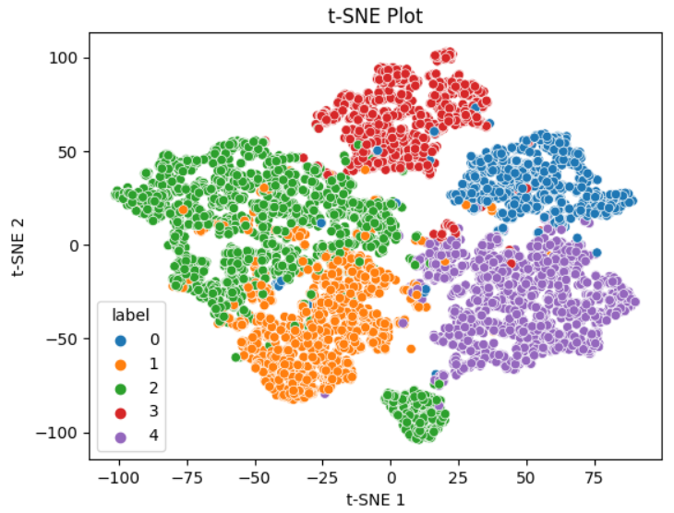
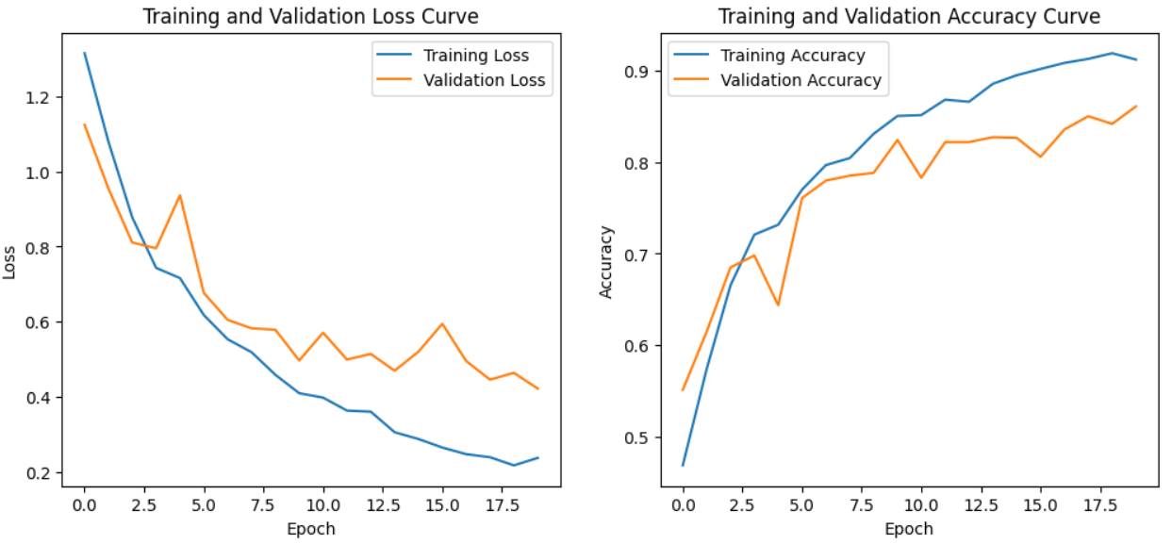
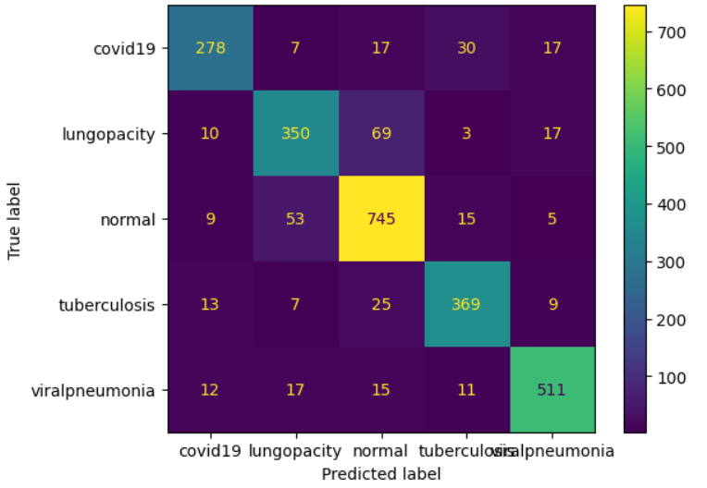
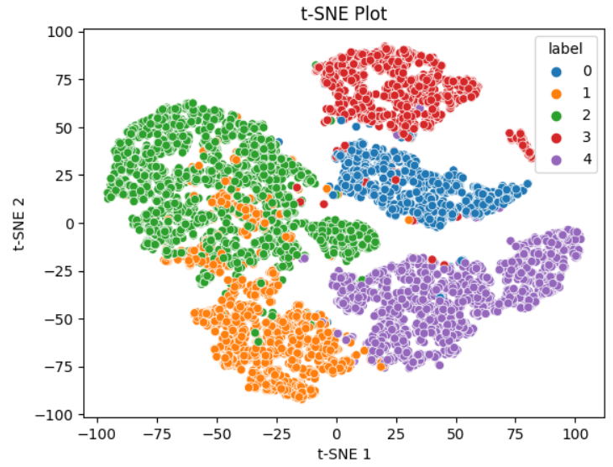
The second dataset, D2, is more complex with a larger number of images, but still well balanced with low variance within each class, and all models perform above 84% accuracy, with AlexNet being the best performing model. However, all models struggle to distinguish between the ‘lung opacity' and 'normal' classes.
ResNet-18 metrics on Dataset2
AlexNet metrics on Dataset2
InceptionV3 metrics on Dataset2

Slide 7
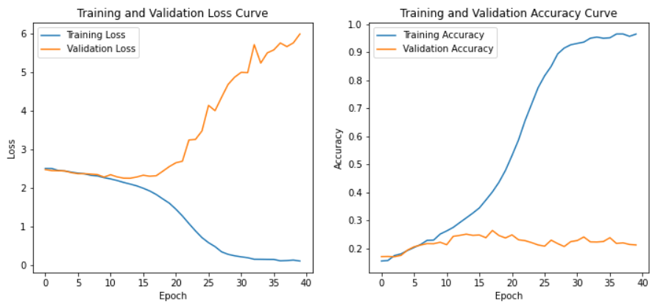
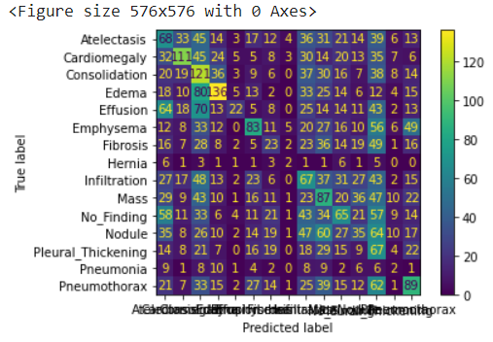
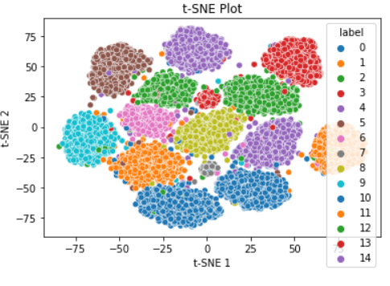
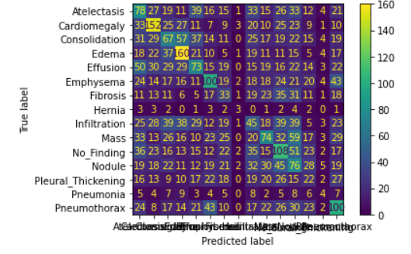
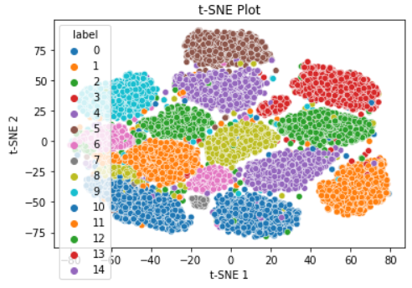
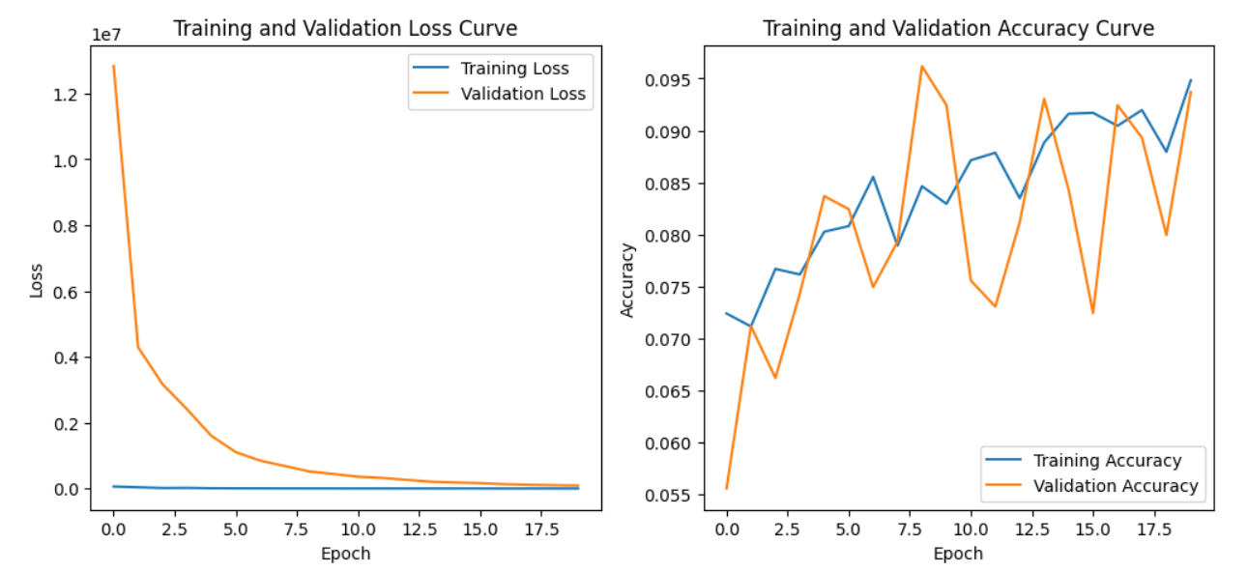
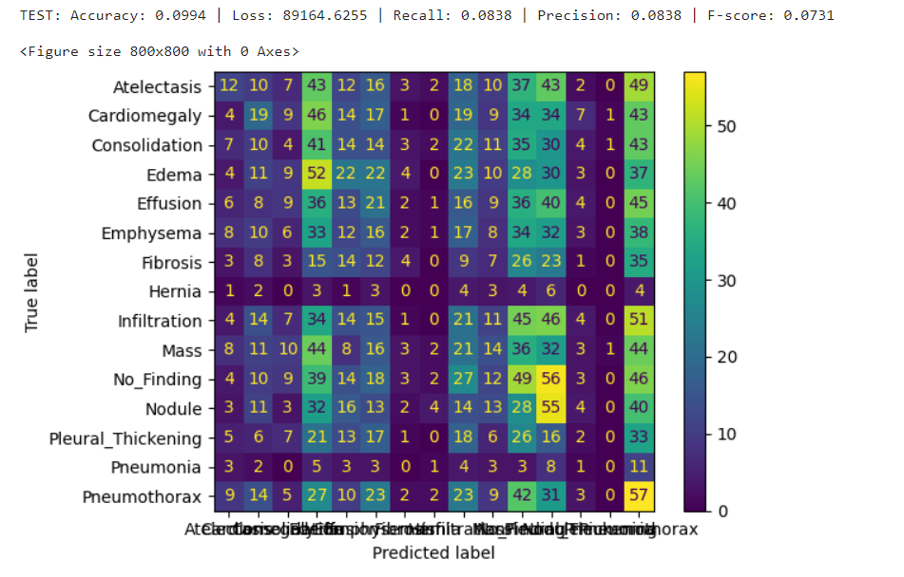
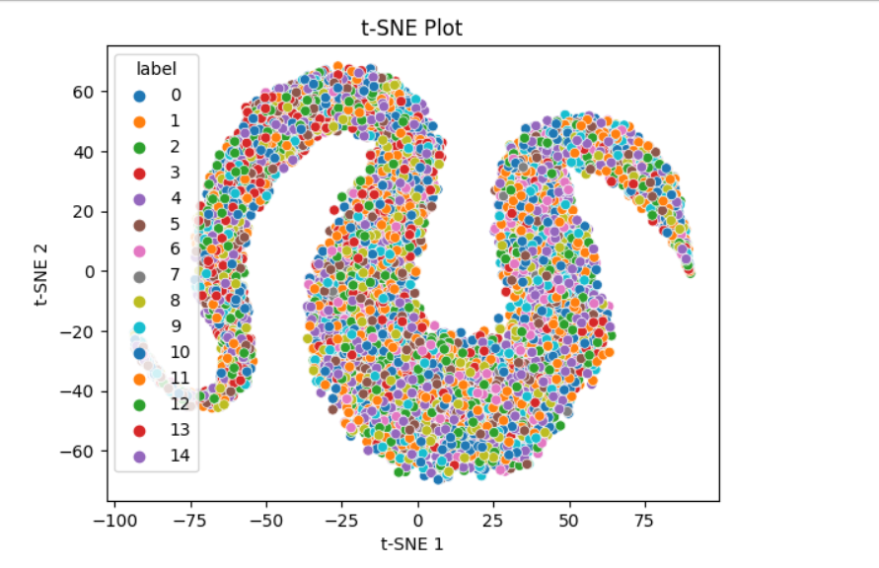
The third dataset, D3, is the most complex with fewer samples per class, designed for image segmentation/localization tasks
Resnet18 metrics on Dataset3
AlexNet metrics on Dataset3
InceptionV3 metrics on Dataset3

Slide 8
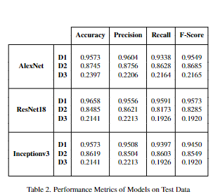
MAIN RESULTS
For dataset 3, all models show significantly low performance, with accuracy not crossing 30%. we concluded that the low performance is attributed to the dataset and not the models itself. The following are the most probable causes for this behavior.
1. Fewer number of samples per class, i.e. 1300 images for 12 classes, which is close to 100 images per class, which is very low.
2. The dataset was designed for Image Segmentation/Localization tasks, thus, each image belongs to multiple classes, running a classification task on these images would lead to low performance as we can only take one class per image.
3. Performing hyperparameter tuning at learning rates 0.01, 0.001, 0.005, 0.0001, 0.0005, and 0.00001, and batch sizes 32, 64, 96, 128, and 256 for 10,20, 30, and 40 epochs, it was observed that the models overfit on the data as the training metrics increase gradually as the validation and testing metrics remain stagnant.
ResNet18 and AlexNet models outperform Inceptionv3 due to their smaller architecture and faster training time. This concludes that ResNet18 is the best-performing model overall, due to its residual connections that allow it to learn residual functions and solve the vanishing gradient problem, making it easier to train with relatively fewer learnable parameters.
The Performance Metrics of all 3 models on all the datasets are shown in Table 2. The visualizations are present in the following slides.

Slide 9
TRANSFER LEARNING
INCEPTIONV3 DATASET 3 - DATASET 2
RESNET18 DATASET 2 - DATASET 1
D3 being a more complicated dataset, inceptionv3 learns more parameters
Fine Tuning the model by freezing the encoder weights and allowing the model to train on D2 we optimize the classifier weights of the model.
Transfer Learning actually produces worse results than the inceptionv3 on Dataset 2 itself.
The challenges posed by D3, drive the inceptionv3 to learn the wrong features, and by freezing the encoder weights, the model only updates the classifier which limits the potential of the model to perform better.
The ResNet18 on D2 is initialized as the new model, and no weights are frozen. Both encoder weights and classifier weights are updated.
ResNet18 already provides an exceptional accuracy on D2, however transfer learning from D2 to D1 aims to perform better. But, It can be seen that the models have the same performance.
The difference lies in the training process. The ResNet18 on D1 takes 15 epochs to obtain a validation accuracy of 96% however, the transfer learning model takes 3 epochs.
 | Accuracy | Precision | Recall | F-Score
Inceptionv3 | 0.8619 | 0.8603 | 0.8504 | 0.8549
Inceptionv3 - TL | 0.5992 | 0.6501 | 0.6028 | 0.5880
 | Accuracy | Precision | Recall | F-Score
ResNet18 | 0.9658 | 0.9556 | 0.9591 | 0.9573
ResNet18 - TL | 0.9641 | 0.9597 | 0.9484 | 0.9538
Notes:
INCEPTIONv3: The challenges posed by D3, drive the inceptionv3 to learn the wrong features, and by freezing the encoder weights, the model only updates the classifier which limits the potential of the model to perform better.
ResNet18:

Slide 10
HYPERPARAMETER OPTIMIZATION
Study the behaviour of the AlexNet to hyperparameter optimization. Tune the hyperparameters of the model, and test performance at different values of learning rate for the Adam and Stochastic Gradient Descent optimizers.
Adam Optimizer trains at learning rates 0.005, 0.0001, 0.0005, and 0.00001.
SGD optimizer trains at learning rates 0.05, 0.01, 0.005, and 0.001 and a momentum of 0.95
It can observed that the model performs best with Adam as the optimizer with the learning rate of 0.0001. In the SGD optimizer the learning rate of 0.01 performed significantly better than the others.
Thus, these specific set of hyperparameters were used to train all the other models on their respective datasets.
An hyperparameter optimization with a larger range of learning rates would aid us in finding the ideal set to obtain the best results and learn the most important features.
ADAM OPTIMIZER
SGD OPTIMIZER
 | 0.005 | 0.0001 | 0.0005 | 0.00001
ACCURACY | 0.3164 | 0.8539 | 0.8076 | 0.7112
PRECISION | 0.0633 | 0.8600 | 0.7991 | 0.6976
RECALL | 0.2000 | 0.8359 | 0.7972 | 0.6884
F-SCORE | 0.0961 | 0.8462 | 0.7960 | 0.6915
0.05 | 0.01 | 0.005 | 0.001
0.1335 | 0.8034 | 0.7640 | 0.6477
0.0267 | 0.8052 | 0.7983 | 0.6610
0.2000 | 0.7843 | 0.7945 | 0.6011
0.0471 | 0.7925 | 0.7937 | 0.6095

Slide 11
REFERENCES
[1] Enes Ayan and Halil Murat ̈Unver. Diagnosis of pneumonia from chest x-ray images using deep learning In 2019 Scientific Meeting on Electrical-Electronics & Biomedical Engineering and Computer Science (EBBT), pages 1–5. Ieee, 2019.
[2] Arkaprabha Basu, Sourav Das, Susmita Ghosh, Sankha Mullick, Avisek Gupta, and Swagatam Das. Chest X-Ray Dataset for Respiratory Disease Classification, 2021.
[3] Hilary Brueck. The newest version of chatgpt passed the us medical licensing exam with flying colors and diagnosed a 1 in 100,000 condition in seconds, Apr 2023.
[4] Erdi C ̧ allı, Ecem Sogancioglu, Bram van Ginneken, Kicky G van Leeuwen, and Keelin Murphy. Deep learning for chest x-ray analysis: A survey. Medical Image Analysis, 72:102125, 2021.
[5] OpenAI ChatGPT. Gflops., 2023.
[6] NATIONAL INSTITUTES OF HEALTH CHEST X-RAY DATASET. Nih chest x-rays — kaggle.com. https : / / www . kaggle . com / datasets / nih- chest- xrays/data. Accessed 10-Mar-2023.
[7] Ross Girshick, Jeff Donahue, Trevor Darrell, and Jitendra Malik. Rich feature hierarchies for accurate object detection and semantic segmentation. In Proceedings of the IEEE conference on computer vision and pattern recognition, pages 580–587, 2014.
[8] Kaiming He, Xiangyu Zhang, Shaoqing Ren, and Jian Sun. Deep residual learning for image recognition. In Proceedings of the IEEE conference on computer vision and pattern recognition, pages 770–778, 2016.
[9] Alex Krizhevsky. One weird trick for parallelizing convolutional neural networks, 2014.
[10] sovrasov. sovrasov/flops-counter.pytorch: Issue 16. , github, 2019.
[11] Christian Szegedy, Vincent Vanhoucke, Sergey Ioffe, Jon Shlens, and Zbigniew Wojna. Rethinking the in-ception architecture for computer vision. In Proceed-ings of the IEEE conference on computer vision and pattern recognition, pages 2818–2826, 2016.
[12] UJ-T. Chest xray images to diagnose pneumonia— kaggle.com. https://www.kaggle.com/datasets / paulti / chest- xray- images. Accessed 8-Mar-2023. 2
[13] Xiaosong Wang, Yifan Peng, Le Lu, Zhiyong Lu, Mohammadhadi Bagheri, and Ronald Summers. Chestxray8: Hospital-scale chest x-ray database and bench-marks on weakly-supervised classification and localization of common thorax diseases. In 2017 IEEE Conference on Computer Vision and Pattern Recognition (CVPR), pages 3462–3471, 2017.
[14] Samir S Yadav and Shivajirao M Jadhav. Deep convolutional neural network based medical image classification for disease diagnosis. Journal of Big data,6(1):1–18, 2019.

